Slide 1
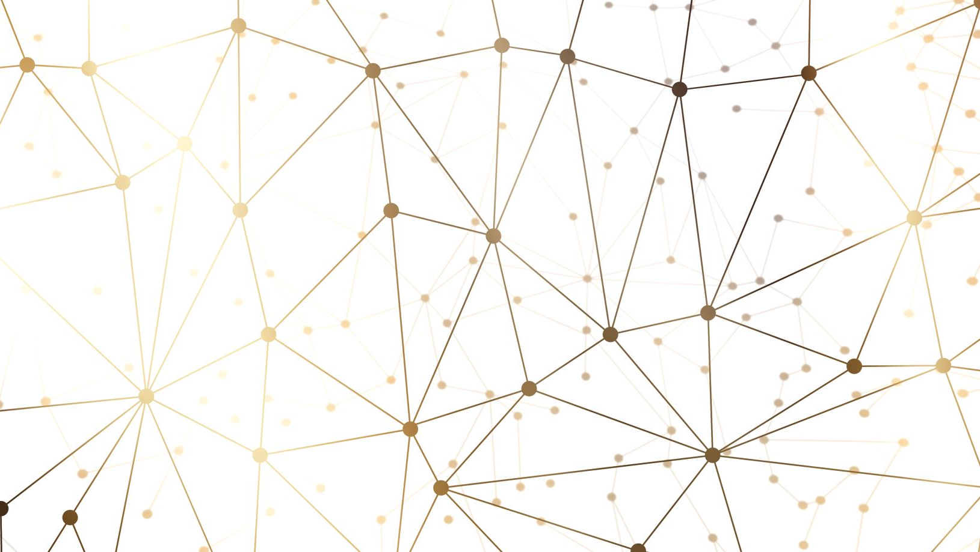
Applying ResNet34 & 50 On Covid19 Data
Presented by: Gurpreet Singh

Slide 2
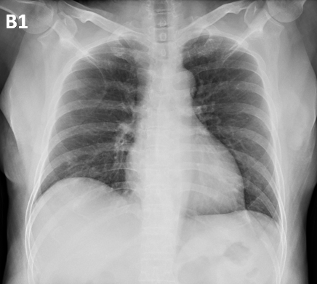
Dataset: Covid-19 Image Dataset
Source: Kaggle
Test and Train directory that contains chest X-Ray pictures
3 Categories: Normal, Covid, Viral Pneumonia
Train: { ‘Covid’ : 111, ‘Normal’ : 70, ‘Viral Pneumonia’: 70 }
Test: { ‘Covid’ : 26, ‘Normal’ : 20, ‘Viral Pneumonia’: 20 }
Concern: Not enough data
Overfitting or poor results

Slide 3
Data Preprocessing
Iteration # 1:
Image sizes vary, resized to (224, 224)
Appended training and testing data to respective arrays along with its classes
Shuffled data
Divided datapoints by 255
Transformed classes using one-hot-encoding
Iteration #2:
Did all the above using ImageDataGenerator
Data preprocessing utility provided by Keras which allows for data augmentation such as image rescaling, image augmentation, shuffling, etc.
Note: Jupyter notebook crashed with more augmentations

Slide 4
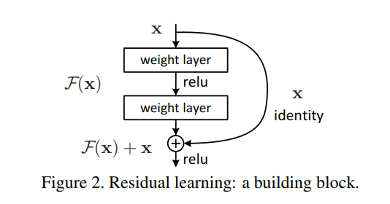
ResNet Explanation
ResNet allows us to train extremely deep neural networks without the vanishing gradient problem
ResNet uses skip connection, which jumps over layers to relay input
This helps prevent the gradient from becoming too small
How it works:
Save the initial input X in variable X_skip
Apply convolutions to X
Add the outputs of convoluted X and original X_skip together
This uses the outputs from before convolution and after convolution to prevent loss
“Deep Residual Learning for Image Recognition” by He et al.

Slide 5
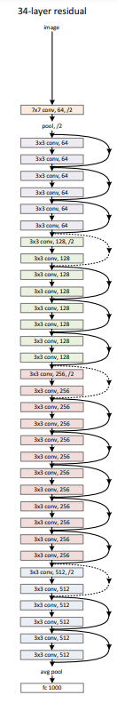
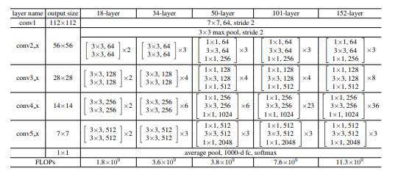
Shortcut connections can only be used when input and output dimensions are the same
When the dimensions increase (look at dotted lines), there are two options
Add zero padding to increase the dimensions (stride = 2)
Skip connection uses 1x1 convolution to project the input to the same dimensions as the output (stride = 2)
Ex: Go from 16x16x64 filter to 8x8x128. ResNet will apply a 1x1x128 (or apply 128 sets of 1x1 filters) to the x_skip to match the dimensions
Stride of 2 skips every other pixel, giving downsampled height and width
“Deep Residual Learning for Image Recognition” by He et al.

Slide 6
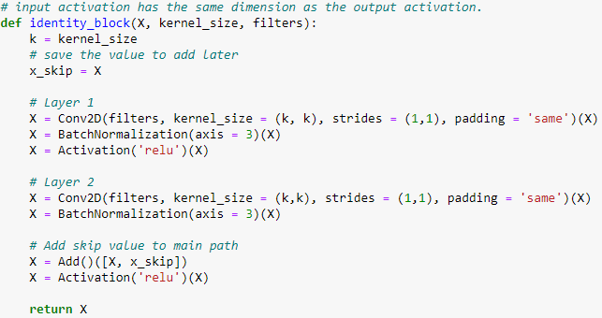
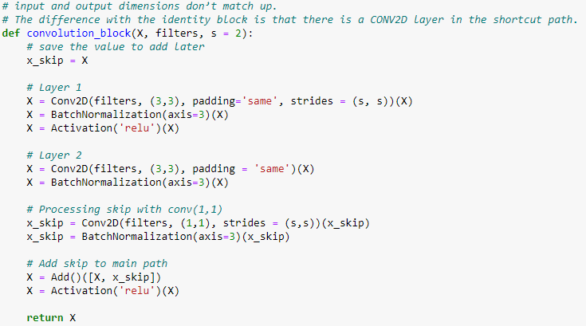
ResNet34 Implementation
Identity Block
Convolution Block
The main difference between both blocks is that the convolution block is used to resize the input into a different dimension so that the addition back to the main path is possible

Slide 7
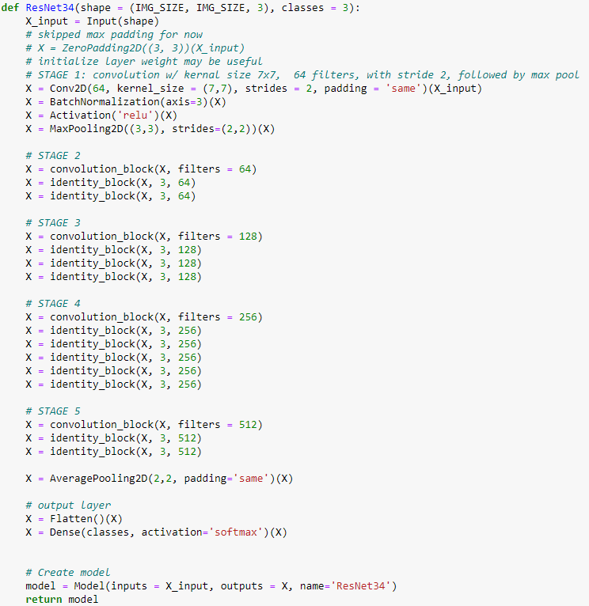
ResNet34 Implementation

Slide 8
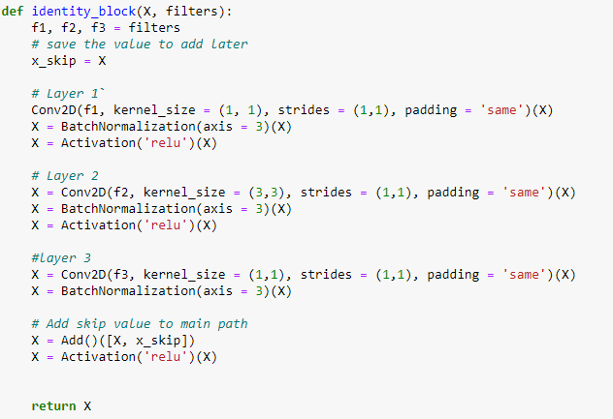
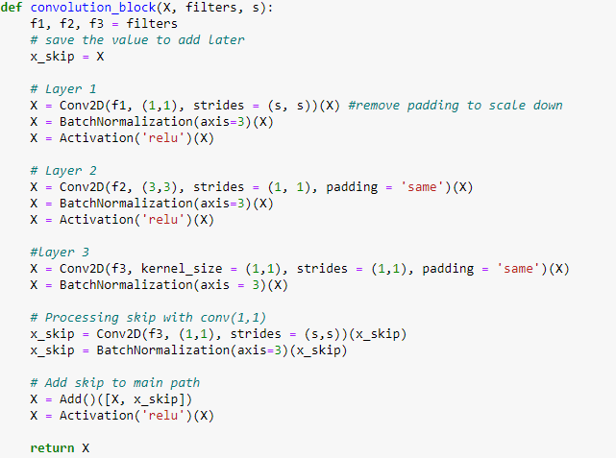
ResNet50 Implementation

Slide 9
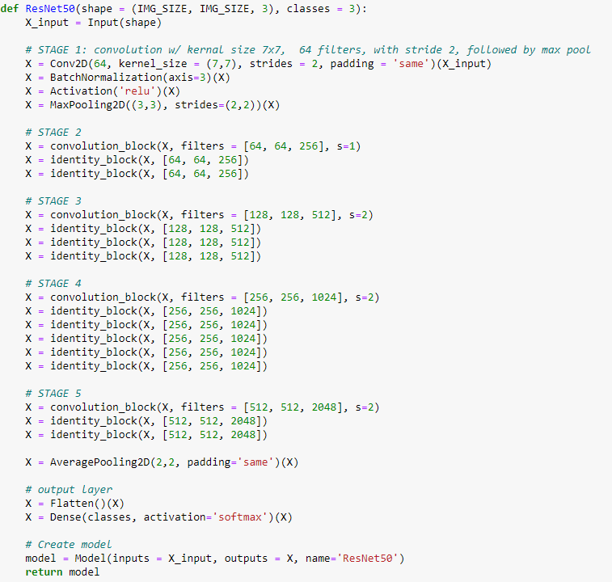
ResNet50 Implementation

Slide 10
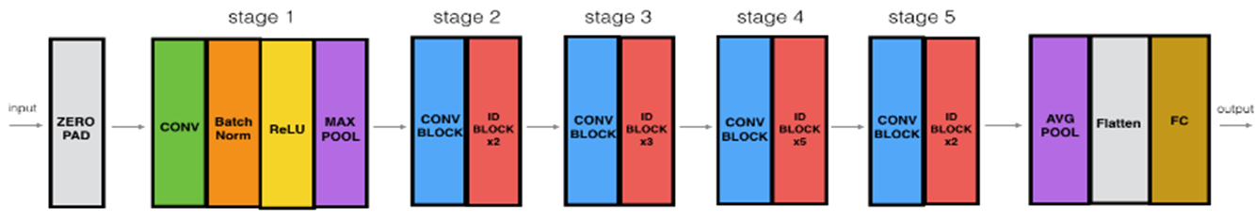

Slide 11
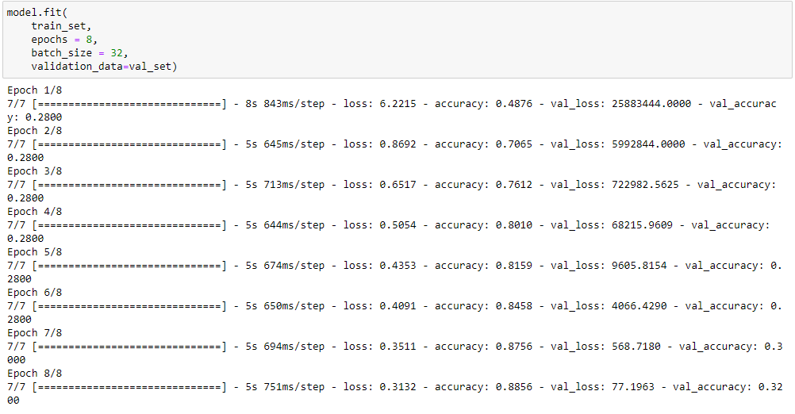
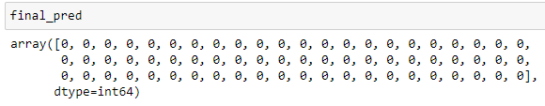
Results
Overfitting due to the low number of samples, minimal data augmentation, and complexity of ResNet
Training accuracy > 90%, but Testing accuracy limited to < 50%
Final prediction only predicts 1-2 classes for all implementations done

Slide 12
Resources
Dwivedi, P. (2019, January 4). Deep-learning/residual_networks_yourself.ipynb at master · Priya-Dwivedi/deep-learning. GitHub. Retrieved May 1, 2023, from https://github.com/priya-dwivedi/Deep-Learning/blob/master/resnet_keras/Residual_Networks_yourself.ipynb
He, K., Zhang, X., Ren, S., & Sun, J. (2016). Deep residual learning for image recognition. 2016 IEEE Conference on Computer Vision and Pattern Recognition (CVPR). https://doi.org/10.1109/cvpr.2016.90
Raikote, P. (2020, April 29). Covid-19 image dataset. Kaggle. Retrieved May 1, 2023, from https://www.kaggle.com/datasets/pranavraikokte/covid19-image-dataset?select=Covid19-dataset

